Slide 1

Project Presentation
Group 4

Slide 2
Datasets
Domain : HR Analytics
Project Name: Employee Attrition
Dataset Name: HR_1 & HR_2
Dataset Type: Excel Data
Dataset Size: 50k records each

Slide 3
KPI’s
Average Attrition rate for all Departments
Average Hourly rate of Male Research Scientist
Attrition rate Vs Monthly income stats
Average working years for each Department
Job Role Vs Work life balance
Attrition rate Vs Year since last promotion relation

Slide 4
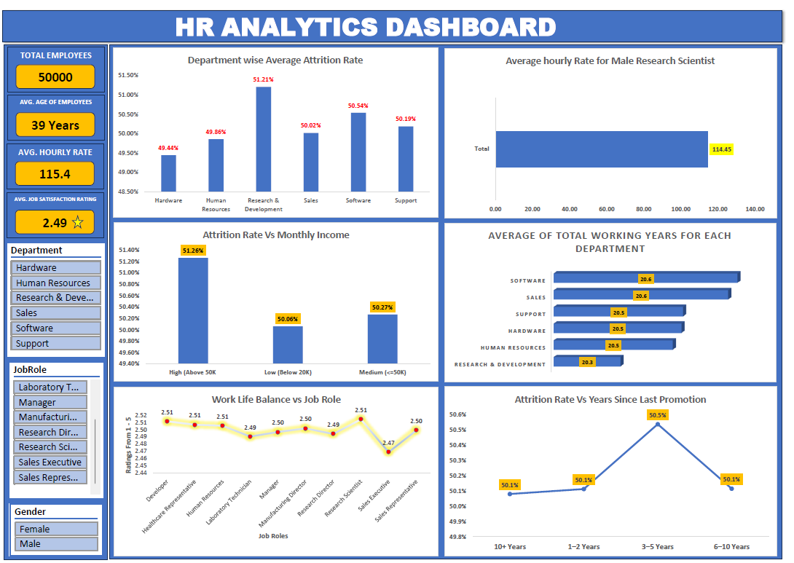
Dashboard Overview

Slide 5
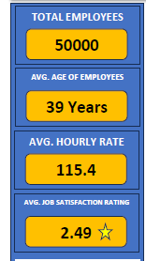
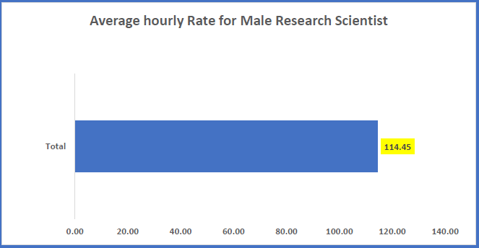
Additional KPI Cards for broader understanding
Total Employees & Workforce Profile
• Total Employees: 50,000
• Average Employee Age: 39 years
• Average Hourly Rate: 115.4
• Average Job Satisfaction: 2.49
Average Hourly rate for Male Research Scientist

Slide 6
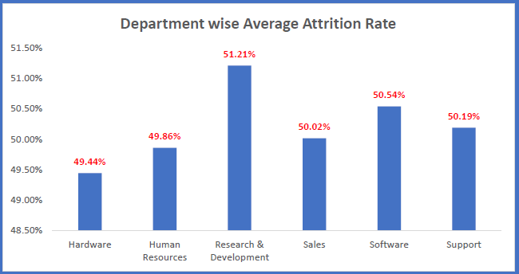
KPI 1 : Department wise Attrition Rate
Key observation:
Attrition rate is by and large very close to each other for each department
R&D department shows the highest attrition rate as compared to other departments.
Such small margins among various dept does not concludes any single department as the cause of high attrition rate in the company

Slide 7
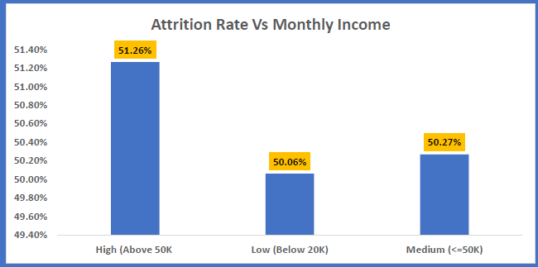
KPI 3 Attrition Rate vs Monthly Income
Key observation:
Attrition rate across all income bands is in the range from 50- 51%.
Employees with salary above 50 k bracket shows signs of highest attrition rate.
Attrition is not only salary-driven; career growth and role stress may play a role.

Slide 8
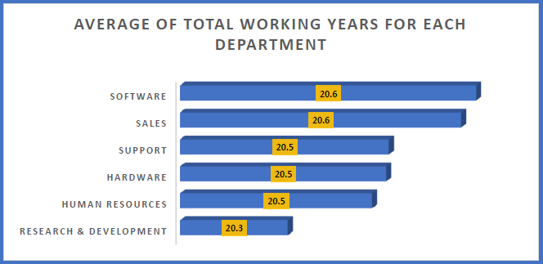
KPI 4: Average of Total Working years for each department
Key observation:
Software & Sales have highest average tenure (~20.6 years)
R&D has the lowest (~20.3 years)
Lower tenure in R&D aligns with higher attrition trend.

Slide 9
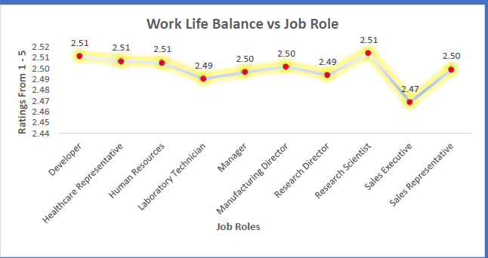
KPI 5:Work life Balance vs Job role
Key observation:
Lowest work-life balance: Sales Executive
Highest balance: Research Scientist
Sales-related roles may need workload and stress management initiatives.

Slide 10
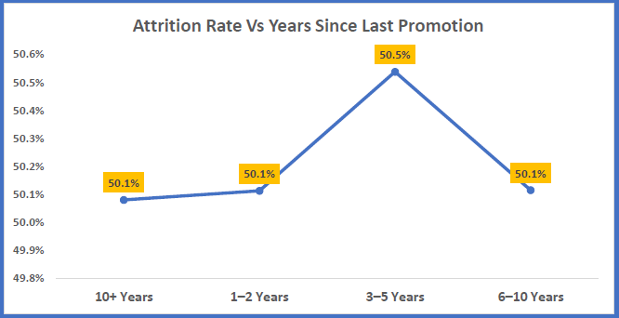
KPI 6 :Attrition Rate vs Years Since last Promotion
Key observation:
Highest attrition at 3–5 years since last promotion
Lack of timely promotions strongly contributes to attrition.
.

Slide 11
Overall Key Observations
Attrition is higher in technical and growth-driven roles
Promotion delays increase exit risk
Work-life balance varies significantly by role
Compensation alone is not the primary driver

Slide 12
Recommendations to Reduce Attrition
Introduce structured career progression & promotion cycles
Improve employee engagement & recognition programs
Enhance work-life balance for sales & operational roles
Conduct stay interviews in high-risk departments
Upskill & internal mobility opportunities for R&D teams

Slide 13
Thank you

